Slide 1













AI in Healthcare
Exploring rapid advancement in FDA authorized medical devices, reliability challenges, growth trends, and evolving regulatory frameworks
Diagnosis
Insights
Advancement
Medical AI Research Institute | 2025
Page 1/9

Slide 2














FDA-Authorized Devices Overview
Analysis of AI/ML systems approved by the FDA
690+ FDA-approved AI/ML systems
Hundreds of AI-powered medical devices have received FDA authorization
75%
Radiology leads with ~75% of approvals
Imaging pairs well with machine learning technology
25%
510(k) pathway dominates
Radiology
Other Categories
Most devices classified as "substantially equivalent" to previously approved tools
Distribution of FDA-approved AI/ML devices by category
Source: FDA data analysis
Page 2/9
Medical AI Research Institute | 2025

Slide 3















Reliability & Generalizability Issues
Findings from the 2025 JAMA Study on AI in Healthcare
Key Study Findings
JAMA study revealed concerns about the reliability and generalizability of FDA-authorized AI medical devices, highlighting transparency gaps across diverse clinical settings.
Limited Transparency
Accuracy Drops in New Environments
Insufficient disclosure of training datasets for FDA-approved AI devices, making it difficult to assess reliability and potential biases.
AI performance often declines significantly when deployed in new clinical settings with different patient populations.
Environment Driven
Critical Concern
Few Demographic Breakdowns
Bias & Inconsistent Results
Rare reporting of performance metrics across different demographic groups, raising concerns about equitable AI deployment.
Risk of algorithmic bias and inconsistent performance outcomes when AI systems are adapted for different hospital populations.
Ethical Concern
System Integrity Risk
Source: 2025 JAMA Study on AI in Healthcare
Page 3/9
Medical AI Research Institute | 2025

Slide 4

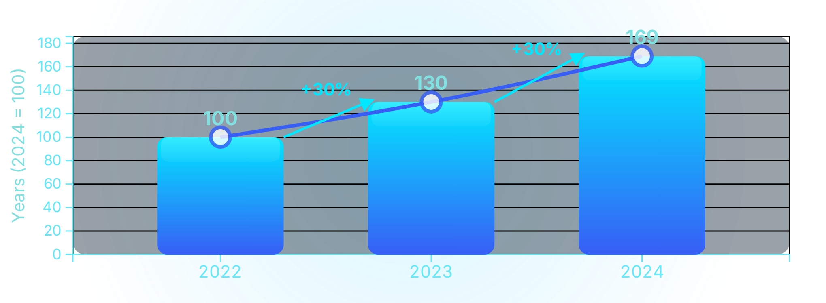













Industry Growth Trends
Analysis of AI device approvals from 2022-2024
Industry Growth
60%
increase in AI device approvals
Workforce Shortages
Diagnostic Backlogs
Rising Investment
Hospitals seek AI solutions for staffing challenges
AI adopted to reduce diagnostic delays
Increased funding from startups and MedTech companies
Source: MedTech Dive analysis
Page 4/9
Medical AI Research Institute | 2025

Slide 5

















Regulatory Challenges
Key issues in regulating AI medical devices
Adaptive AI Behavior
Proprietary Training Data
AI systems can change behavior over time, making regulation difficult as accuracy may shift after deployment.
Training data is often confidential or undisclosed, limiting transparency and validation of AI systems.
Patient-Data Privacy
Post-Market Monitoring
Use of patient data for training raises privacy concerns and regulatory challenges.
Need for continuous monitoring of AI performance in real-world settings.
Regulatory Framework Evolution Path
Pre-Market
Patient Care
Clinical Team
FDA Review Process
Institutional Protocol
Doctor's Decision
Documentation
System Performance
Ongoing Monitoring
Patient Data Management
Machine Learning Standards
Data Collection Feedback Loops
Source: FDA regulatory analysis
Page 5/9
Medical AI Research Institute | 2025

Slide 6















Case Studies
Examples of FDA-authorized AI systems
Viz.ai Stroke Detection
IDx-DR - Iowa Preclinical Diabetes Detection
Real-time CT-based stroke triage
Emergency Triage
Autonomous diabetic retinopathy diagnostic tool
"Accelerated stroke treatment decisions for critical time-sensitive interventions"
Ophthalmology
"Early detection without requiring specialist expertise or office visits"
HeartFlow FFR-CT
Caption Guidance
3D cardiac modeling from CT scans
Real-time ultrasound capture assistance
Cardiology
Imaging Support
"Non-invasive coronary artery assessment reducing unnecessary MRAs"
"Helps novices obtain better quality scans improving diagnostic accuracy"
These AI systems have received FDA authorization under the 510k evaluation pathway
Page 6/9
Medical AI Research Institute | 2025

Slide 7



















Benefits of Medical AI
How AI is improving healthcare delivery and patient outcomes
AI technologies are transforming healthcare by addressing critical challenges and delivering benefits to providers and patients through enhanced efficiency, better resource allocation, and more precise interventions across the healthcare ecosystem.
Faster Diagnosis
Less Clinician Workload
Early Disease Detection
AI systems analyze medical images and data rapidly, reducing diagnosis time by up to 40% in many clinical settings.
AI automates routine tasks and provides decision support to reduce provider burnout while enabling deeper patient interaction.
AI algorithms identify disease markers in early stages that might be invisible to human observation, leading to more effective interventions.
Improved Access
Consistent Imaging Quality
Key Medical AI Impact
AI-powered tools extend specialist capabilities to underserved areas through remote analysis and guided diagnostic workflow.
AI standardizes image acquisition and interpretation across different settings, reducing variability in diagnostic quality.
Diagnostic accuracy increased by 15-30% in radiographic exams
Time from imaging to critical diagnosis reduced by up to 50%
Expanded access to specialized diagnostics in rural and underserved areas
Source: Medical AI Analysis
Page 7/9
Medical AI Research Institute | 2025

Slide 8
























Risks and Limitations
Key concerns with current medical AI implementations
Algorithmic Bias
Critical
AI systems can perpetuate biases in training data, leading to unequal treatment across demographics, particularly affecting minority populations and underrepresented patient groups.
Accuracy Variations
Warning
Key Medical AI Risks
FDA-authorized devices often fail to generalize to hospitals with different populations, with performance dropping significantly when deploying in new clinical environments.
Algorithmic Bias
Accuracy Variations
Data Privacy Vulnerabilities
Warning
Proprietary training data raises concerns about patient privacy, with risks of data misuse and insufficient transparency in how patient data is collected and utilized.
Data Privacy
Oversight Complexity
Overreliance on Automation
Critical
The more complex and less transparent AI systems become, the more difficult it is for clinicians to understand their decision-making process, leading to overconfidence in potentially incorrect diagnoses.
Source: FDA analysis and industry reports
Page 8/9
Medical AI Research Institute | 2025

Slide 9



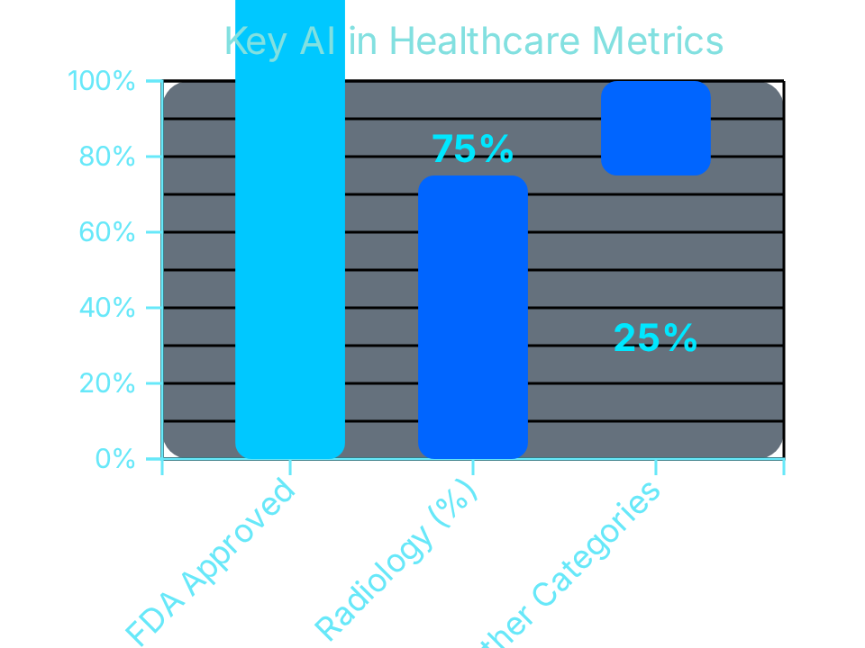









Summary and Key Findings
Key trends and considerations from AI in healthcare
Rapid Expansion
690+ FDA-approved AI medical devices representing rapid growth in the healthcare technology sector, with 60% annual growth from 2022 to 2024.
Radiology Dominance
75% of FDA approvals have been in radiology and imaging, where AI models complement human radiologists by automating routine workflows and flagging potential areas of concern.
Future Direction
Unresolved Reliability Concerns
Transparent data disclosure standards required
Despite significant growth, transparency gaps on training data distributions and demographic performance variations remain concerns for reliable AI deployment across diverse healthcare environments.
Improved post-market monitoring systems
Ethical AI development frameworks
"Transparent data practices and regulatory evolution are essential for trust in healthcare AI"
Evolving Regulatory Frameworks
Regulatory bodies struggle to keep pace with adaptive AI technologies, creating gaps between initial approval and continuous post-market monitoring of newer AI systems.
Source: FDA data analysis
Page 9/9
AI Healthcare Summit 2025 | Processing 690+ algorithms

